Slide 1

16-bit Microcomputer in a FPGA
Ryan November

Slide 2
Project Goals
Use the building blocks presented in Digital Circuit Principles/Design courses to implement a more complicated system
Learn basic computer architecture by creating a simple microcomputer that can be operated in a FPGA
Develop an understanding of how computer programs are executed at the hardware level and bridge the gap between high level programming languages and program execution in hardware

Slide 3
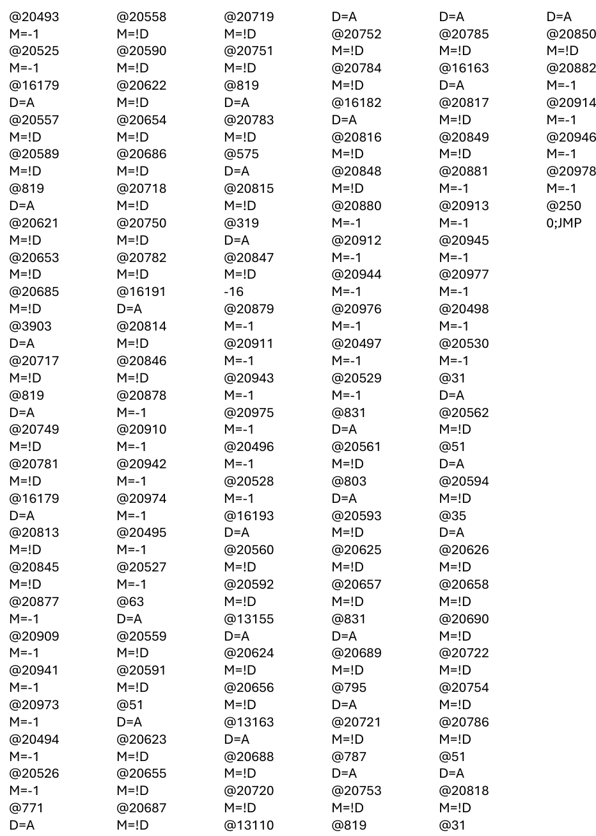
Project Goals - Continued
Print(“Hello, World”)
Python – 1 line
Hack Assembly – 253 lines

Slide 4
What is an FPGA?
Field Programmable Gate Array
Consists of blocks of logic interconnected via switches
Logic blocks and switches can be configured to realize a specific functionality
Provides a useful platform for prototyping circuits

Slide 5
Project Overview
2 main parts:
6 virtual projects from the book The Elements of Computing Systems
Projects walk through the design of a basic microcomputer called “Hack” using a web-based simulation environment
Implement a microcomputer system based on the Hack architecture that can be operated in a FPGA

Slide 6
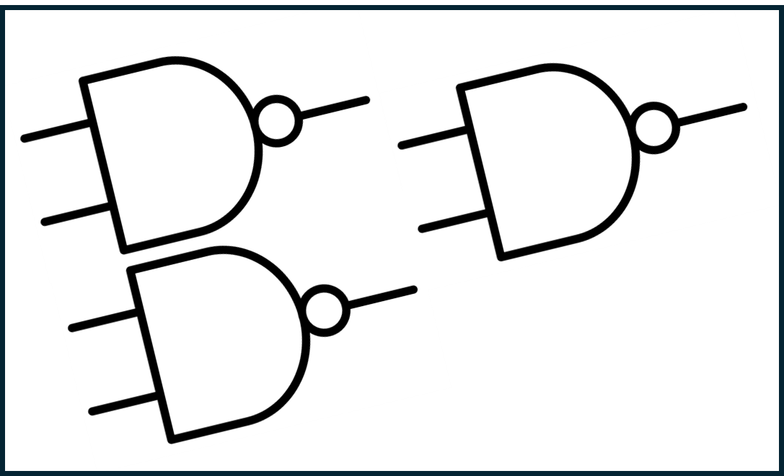
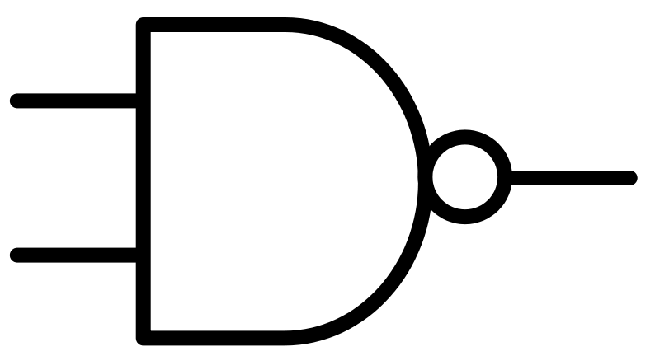
The Elements of Computing Systems - Overview
The NAND gate is the fundamental logic block with which all necessary components used in a computer can be constructed
NAND
Logic Device Built with Gates
Increasingly complicated systems built from smaller devices

Slide 7
“Black Box” Approach
Abstraction – once a component is created, we characterize it by the behavior of its inputs and outputs
A device becomes a “black box” – we don’t care what is inside the box
We only care about what comes out of the box in relation to what goes in
Notes:
Once a Device is built it becomes a “box” – only concerned with behavior of box, not what is inside it (inside is abstracted away)

Slide 8
The Elements of Computing Systems Projects
Project 1 – Boolean Logic
Gates, Multiplexers, Demultiplexers
Project 2 – Boolean Arithmetic
Adder, Incrementer, Arithmetic Logic Unit (ALU)
Project 3 – Memory
Register, RAM, Program Counter
Project 4 – Machine Language
Assembly language programming
Project 5 – Computer Architecture
CPU, Memory Module
Project 6 – Assembler
Translates assembly instructions into binary - Python

Slide 9

Hardware Implementation
VHDL – Very High-Speed Integrated Circuit Hardware Description Language
VHDL provides a method to represent a physical circuit with written code
VHDL code is used to instantiate a circuit in the FPGA
CPU
RAM
ROM
VGA

Slide 10
Hardware Implementation – Continued
Microcomputer is made up of CPU, Instruction Memory (ROM), and Data Memory (RAM) modules
External modules developed to interact with peripheral devices
VGA Controller – enables the microcomputer to interface with a VGA computer monitor
Debugger – sends various internal data to external displays on the FPGA board
CPU
RAM
ROM
VGA

Slide 11
Hardware Implementation – Considerations
Primary concern is data movement within the system
Data must be sent/received between subcomponents in a predictable fashion for the computer to properly execute instructions
The way data is transported around and manipulated by the computer defines the architecture
CPU
RAM
ROM
VGA

Slide 12
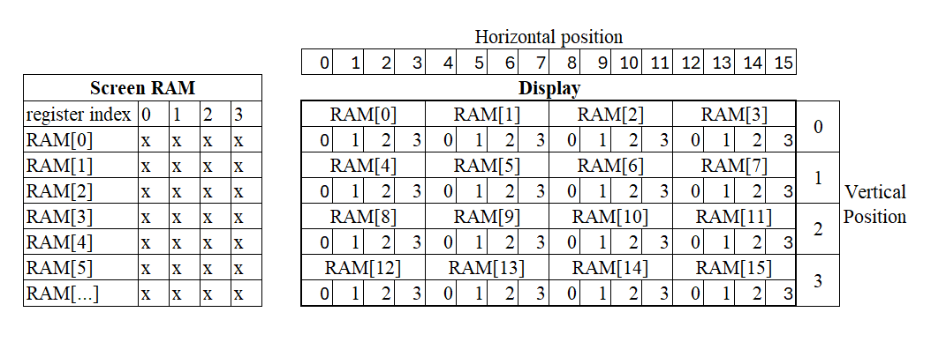
VGA Controller and Memory Mapped I/O

Slide 13
Debugger
Provides a “window” inside of the computer
Used to observe data moving through CPU (internal registers) and memory
Can observe current instruction being executed and the program count
Manual clock operation allows for execution of a program line-by-line with the ability to observe contents of internal registers and memory at each instruction
Incredibly useful tool to demonstrate connection between software and hardware

Slide 14
Big Picture
Powerful prototyping platform that allows for the detailed observation of data flow in hardware for a user-written assembly program
Bridges the gap between hardware and software understanding
Computer itself is a “black box”
Takes in user-written code as input
Gives some output based on program written (i.e. text on screen)

Slide 15
Possibilities for Expansion
Write a C compiler for the Hack platform allowing for execution of C – language programs
Demonstrate connection between higher – level programming languages and how their instructions are executed in hardware
Expand ISA to include more operations in hardware (multiplication, bitwise shifts, etc.)
Add support for keyboard and mouse
Would require a controller to “decode” data from keyboard/mouse and map it to a specific location in memory

